Slide 1
Terraform - Module 302
April - 2023

Slide 2

Table of contents
Introduction to PAAC
Creating Terraform file and Pushing it to GitHub
Creating Sentinel Workspace
Generating Mocks
Sample Mock Files
Creating Sentinel Policy
Testing Sentinel Policy

Slide 3

Introduction to PAAC

Slide 4
Introduction to PAAC
Terraform is a tool for building, changing, and versioning infrastructure safely and efficiently.
Sentinel is an embedded policy-as-code framework integrated with the HashiCorp Enterprise products. It enables fine-grained, logic-based policy decisions, and can be extended to use information from external sources.
Secure Terraform Plan before Applying it to infrastructure using a Policy as a Code(PaaC) tool i.e. Sentinel from Hashicorp.
Notes:
Reference : https://medium.com/ruki-techspacee/secure-terraform-using-sentinel-d3aa0fa7c45e

Slide 5

What is PAAC?
Challenge
Manual security and compliance checks create bottlenecks
Ticket-based review processes are a bottleneck that can slow down development
Solution
Automated guardrails around multi-cloud provisioning
Sentinel can be used as a policy as code framework to automatically enforce compliance and governance policies before Terraform makes infrastructure changes.

Slide 6
Creating Terraform file and Pushing it to GitHub

Slide 7
Prerequisites
Sentinel Installed in your device
Terraform Installed in your device
GitBash Installed in your device
GitHub Account
Terraform Cloud Account
AWS Account
SSH connection to GitHub

Slide 8
Basic Methodology for Restricting Resources
The Eight Steps of the recommended methodology are:
Create a Terraform configuration that creates the resource.
Create a workspace that uses your Terraform configuration.
Run a plan against the workspace.
Generate mocks against the plan in the TFC UI.
Write a new Sentinel policy.
Create test cases and test your policy with the Sentinel CLI.
Revise your policy and test cases until the latter all pass.
Deploy your policy to a TFC organization.

Slide 9
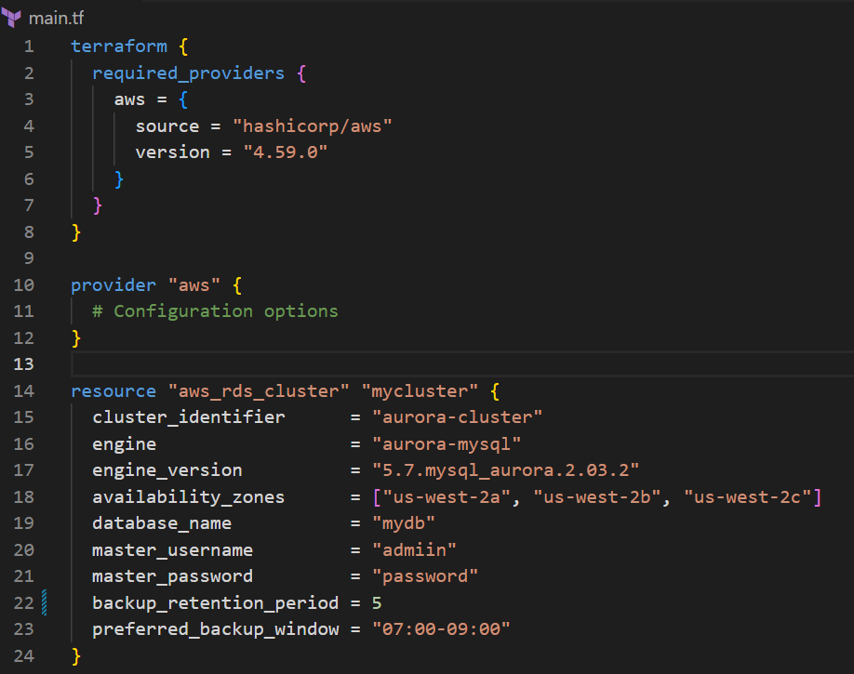
Terraform File for Resource Deployment

Slide 10
Push your main.tf file into your GitHub Repository
Create a GitHub Repository and run below commands to push your main.tf file into your GitHub repository
Git init
Git branch –M main
Git remote add origin git@github.com:<git hub account username>/<repository_name>.git
Git add main.tf
Git commit –m “first commit”
Git push –u origin main

Slide 11
Creating Sentinel Workspace

Slide 12
Create a Workspace in the TFC/TFE UI
Visit this website https://app.terraform.io/session
Create a Terraform Cloud account
Verify your email
Create an organization in Terraform Cloud
Create a Workspace using the Version control workflow (GitHub)

Slide 13
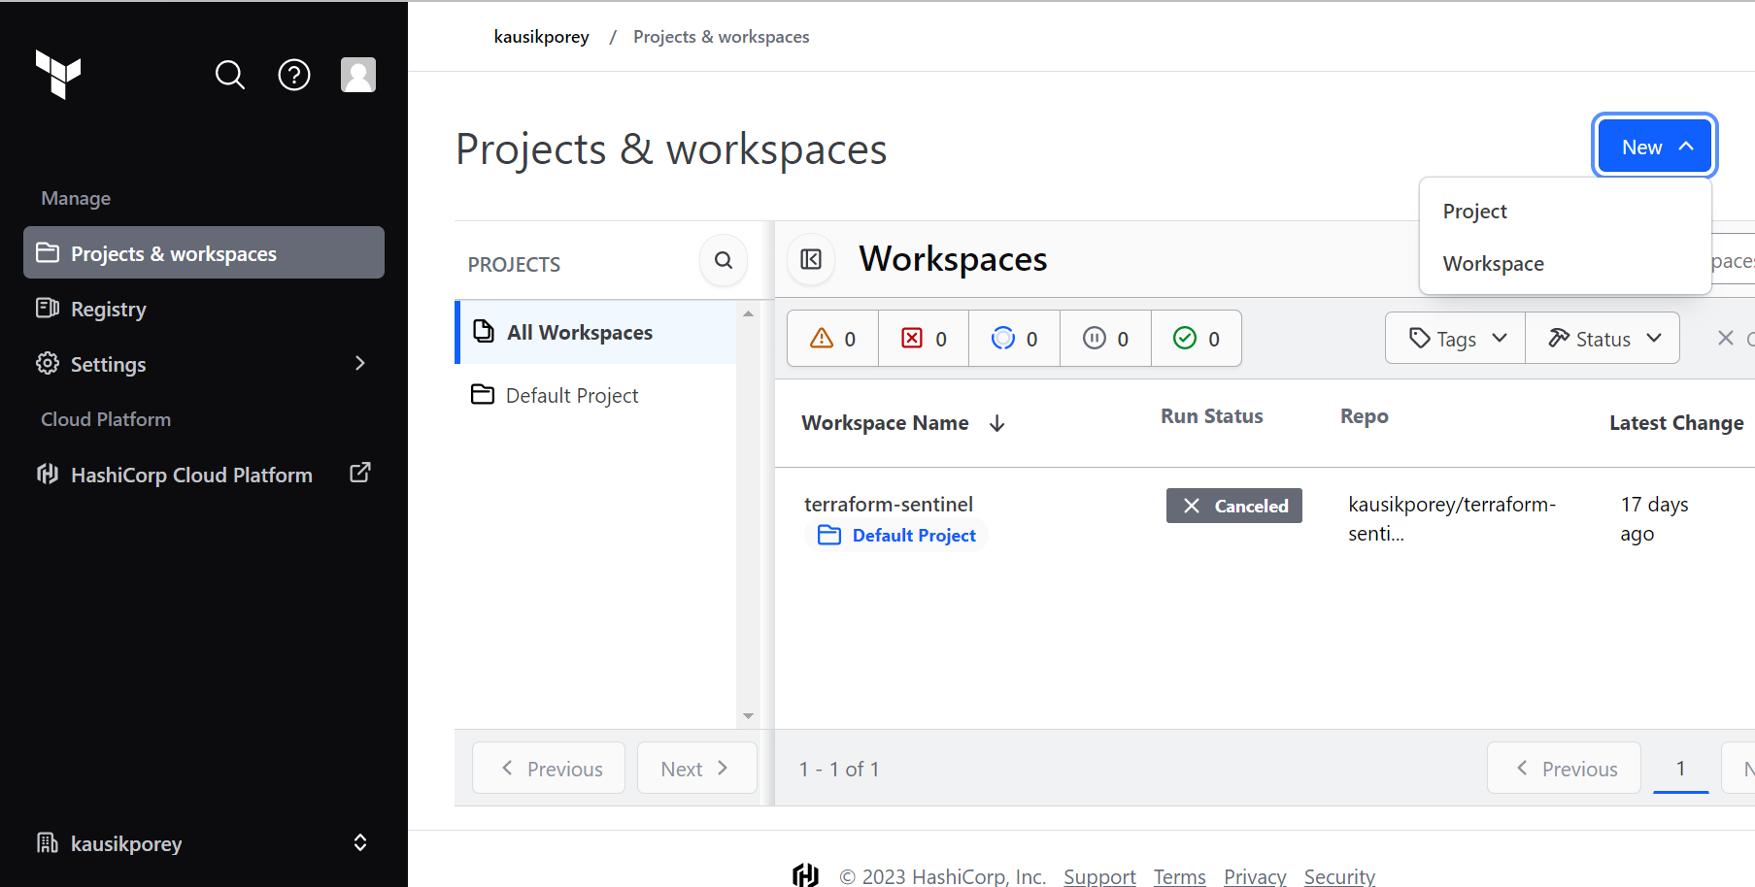
Creating Workspace 1
Click on ‘New’ and then Click on ‘Workspace’

Slide 14
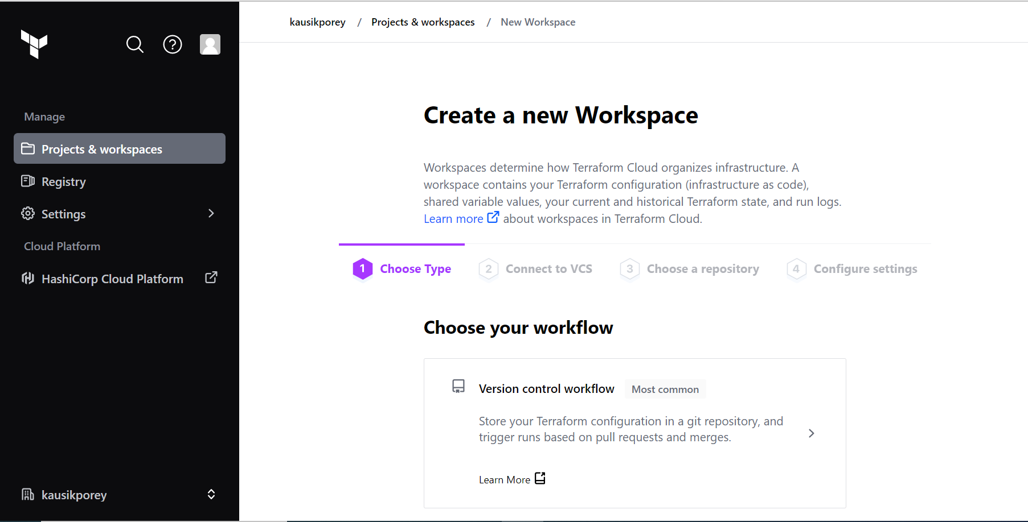
Creating Workspace 2
Click on ‘Version control workflow’

Slide 15
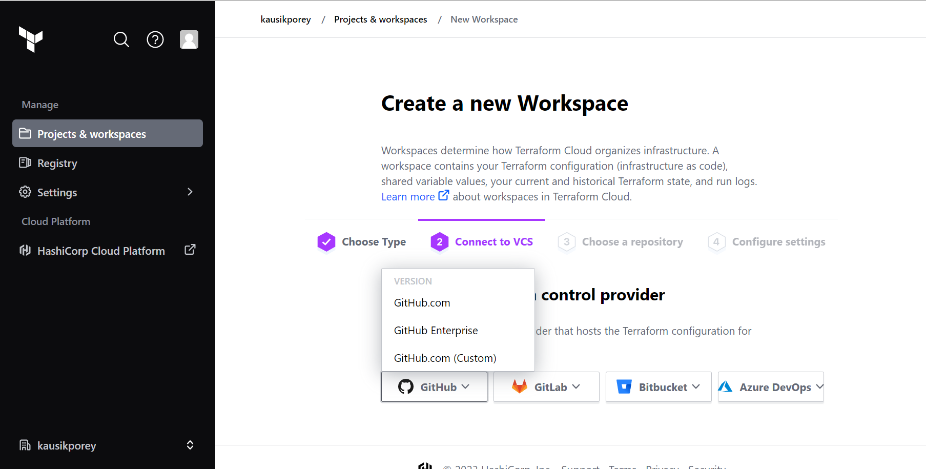
Creating Workspace 3
Click on ‘GitHub’ dropdown menu and select ‘GitHub.com’
It will redirects you to a different screen. Click on ‘Authorize terraform cloud’.

Slide 16
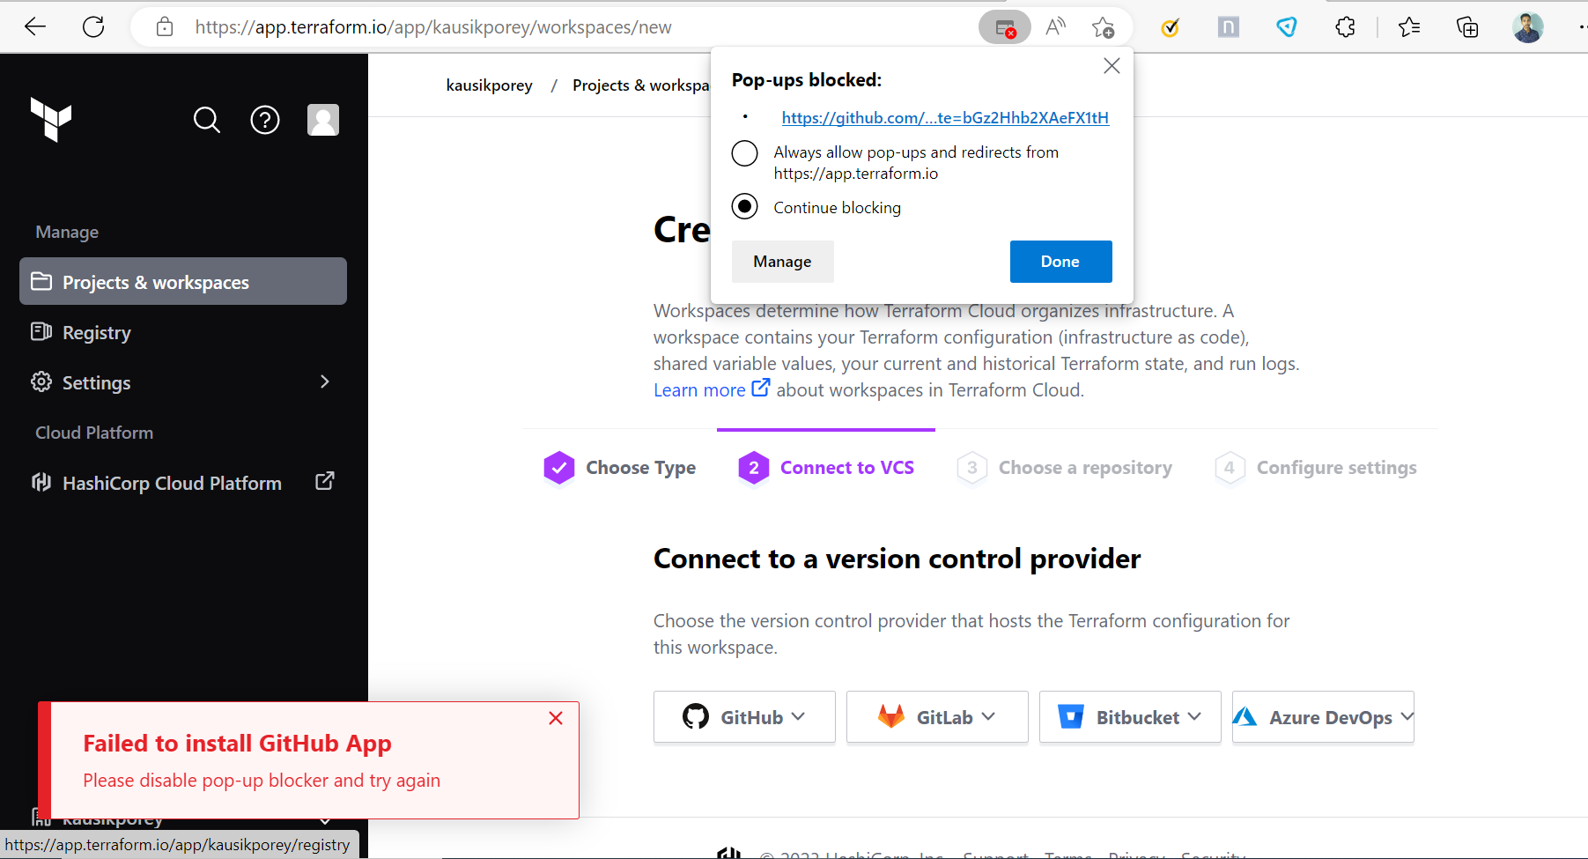

Creating Workspace 4
You might get an error if your browser blocks your pop-ups
Click on the red cross icon in your browser search box and choose ‘Always allow pop-ups and redirects from https://app.terraform.io’
Then again follow the steps mentioned in the previous slide

Slide 17
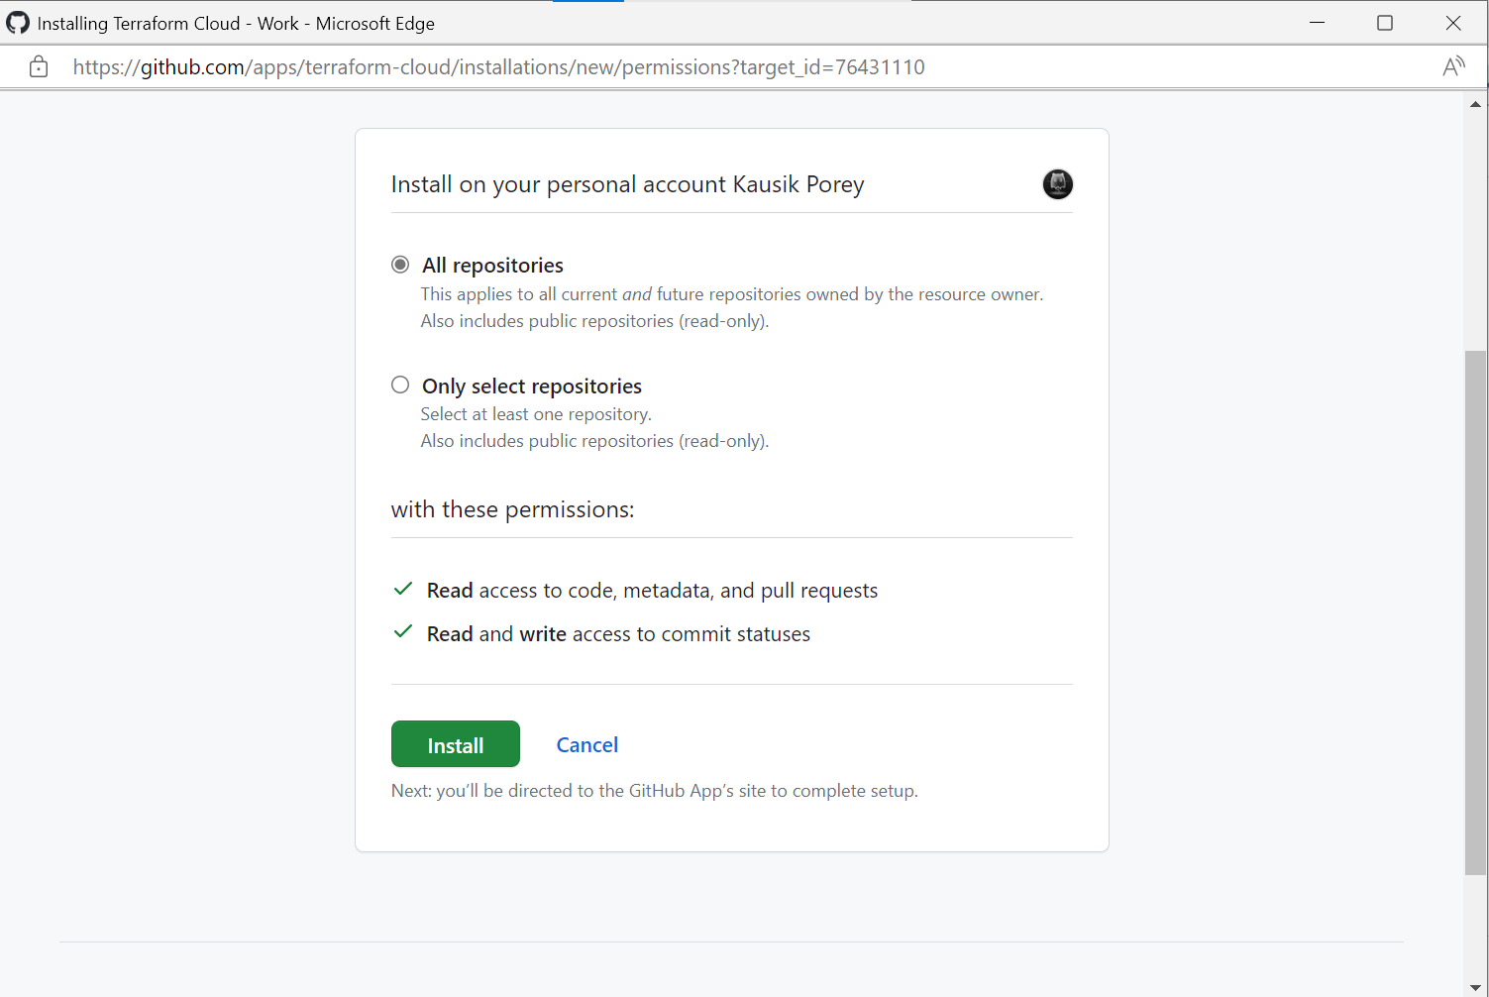
Creating Workspace 5
Select ‘All repositories’ and click on ‘Install’ button

Slide 18
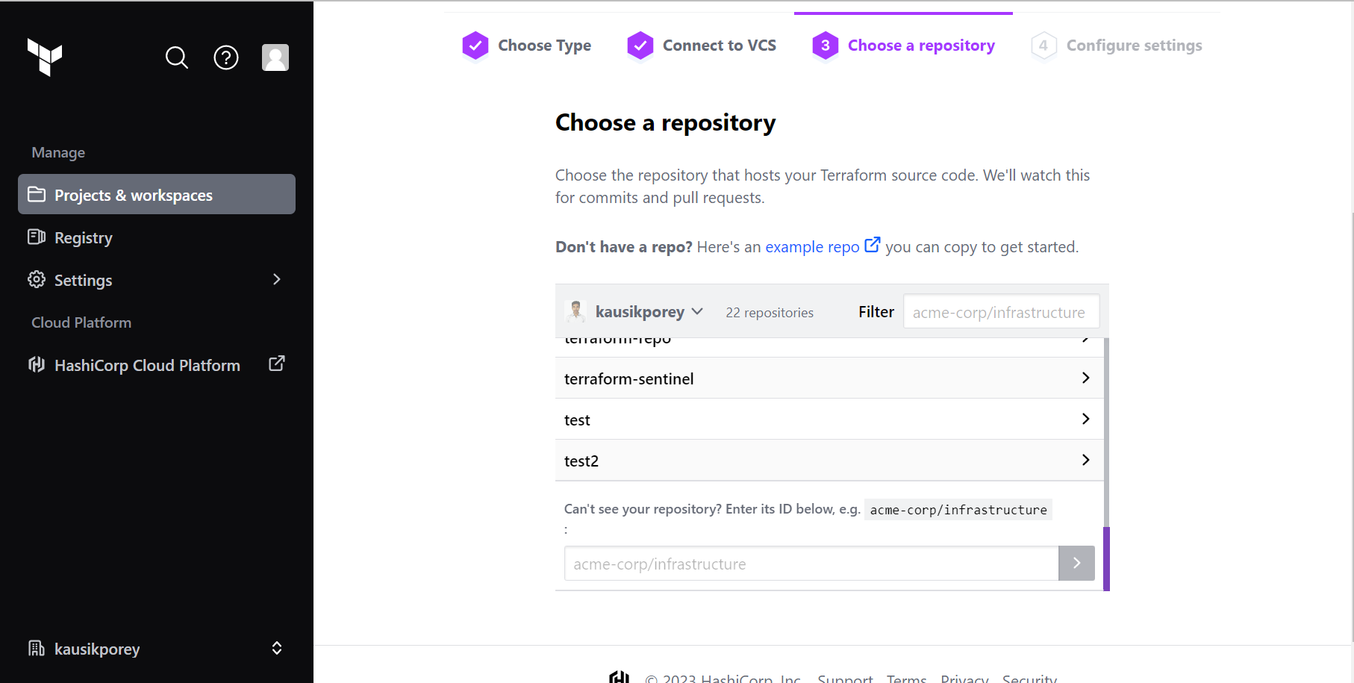
Creating Workspace 6
Choose your GitHub repository which you created earlier.

Slide 19
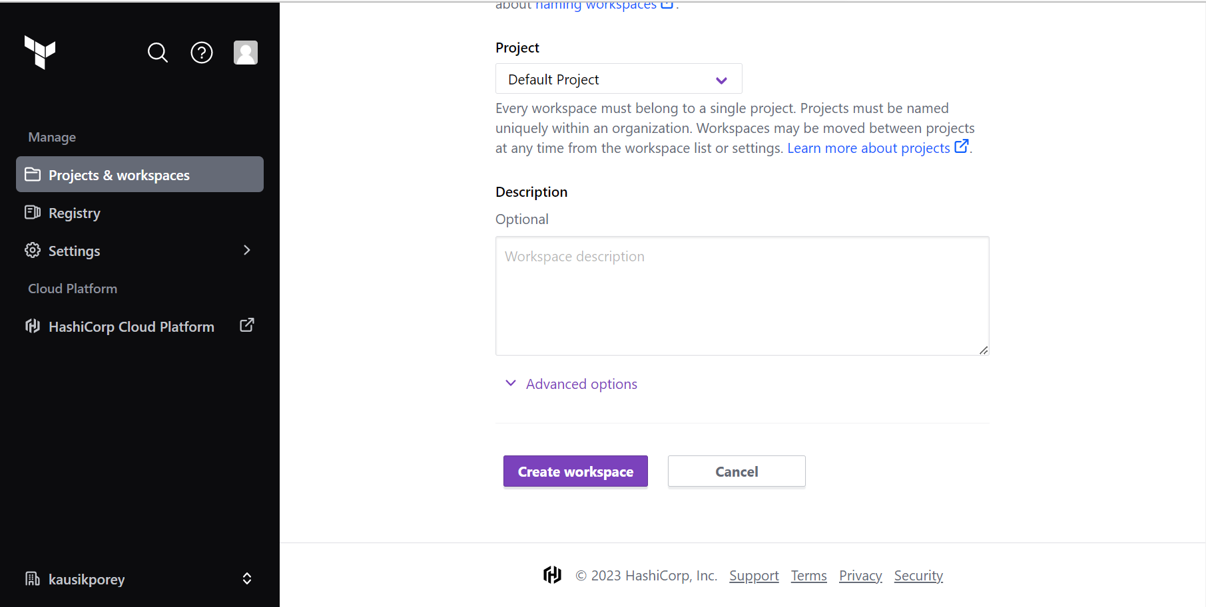
Creating Workspace 7
Click on ‘Create workspace’ button

Slide 20
Generating Mocks

Slide 21
Run a Plan and Generate Mocks Against It
Open your Terraform Cloud and run a plan against your configuration.
To generate mocks against your plan, click the "Download Sentinel mocks" button.
After a minute, a tar.gz file will be downloaded with 7 mocks.
Extract the mock files from the tar.gz file.

Slide 22
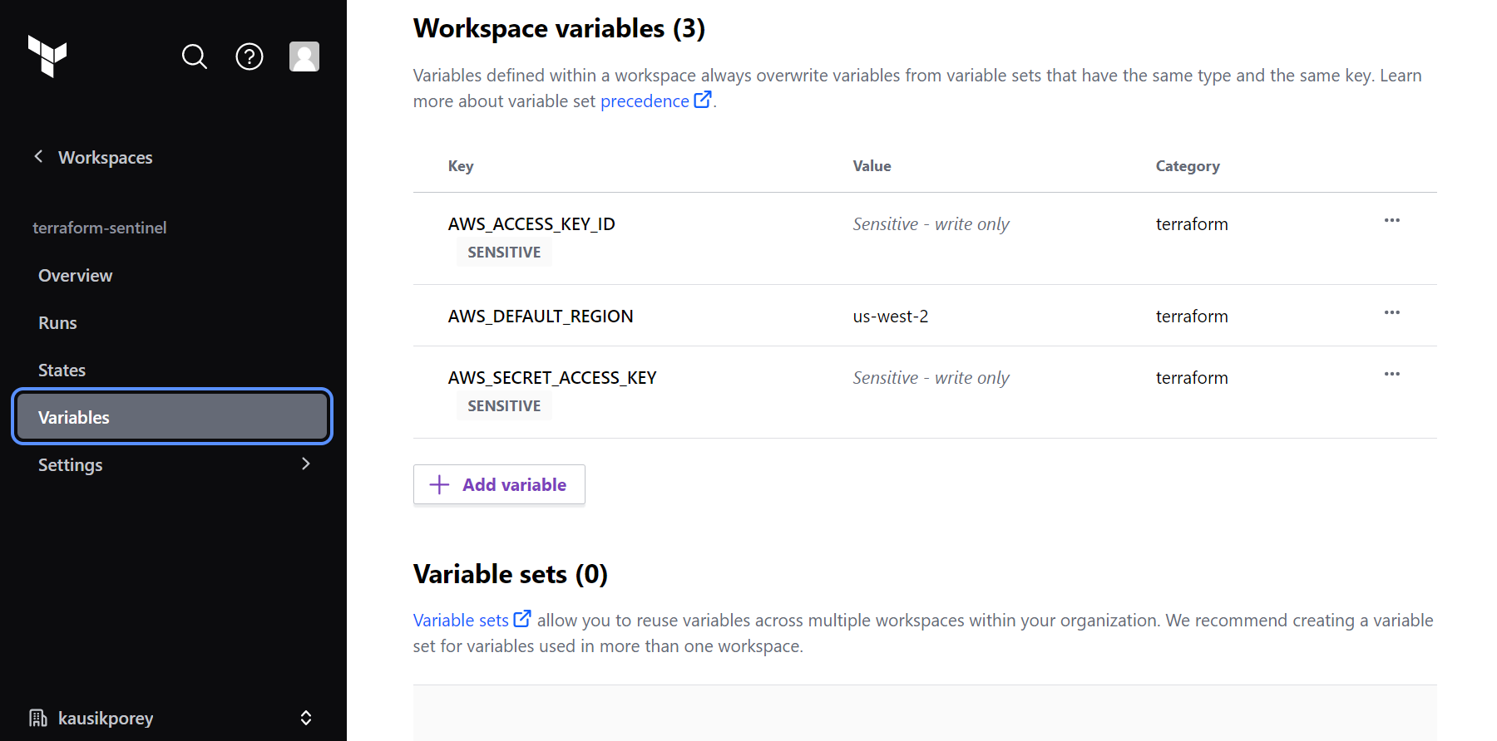
Set Variables in Your Workspace

Slide 23
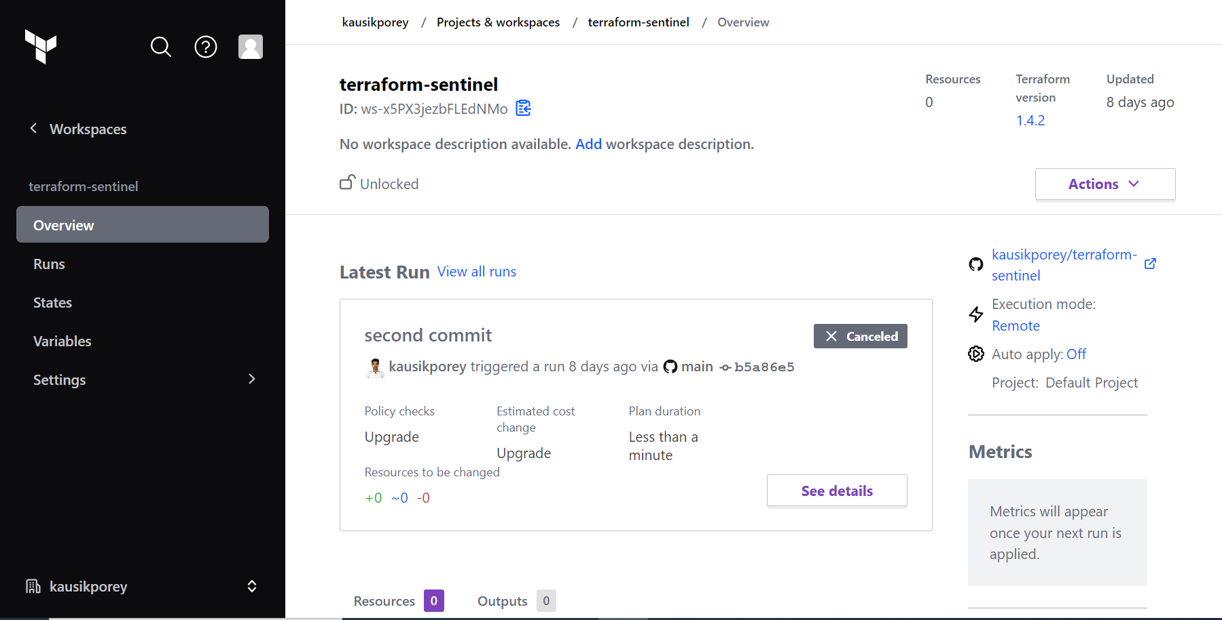

Run a Plan

Slide 24
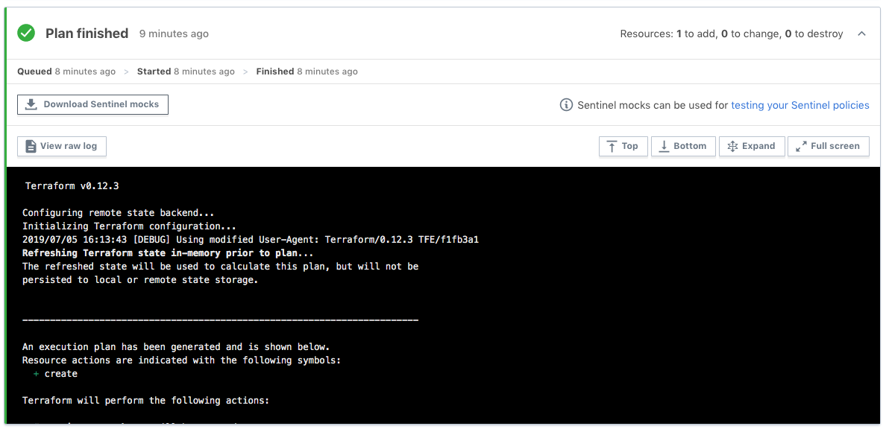
Generate Mocks Against Your Plan

Slide 25
Sample Mock Files

Slide 26
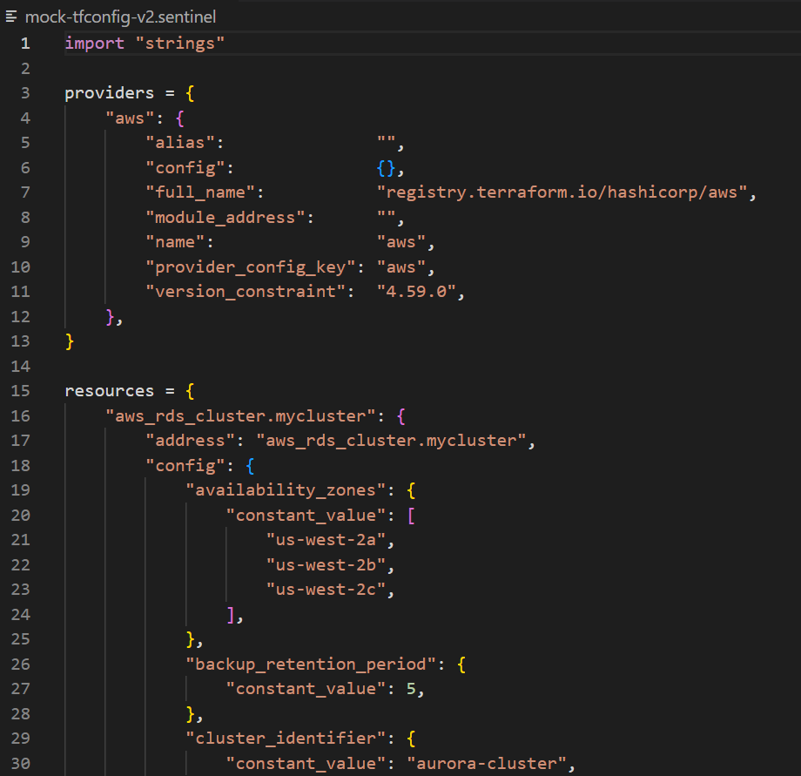
Mock file for tfconfig-v2

Slide 27
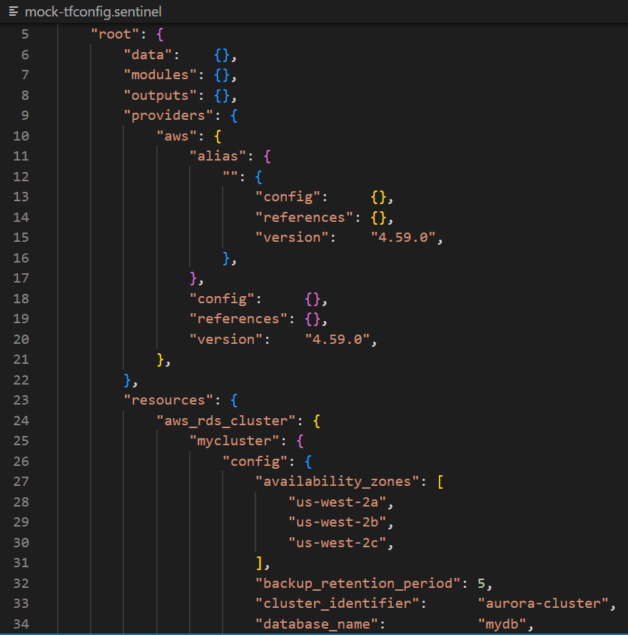
Mock file for tfconfig

Slide 28
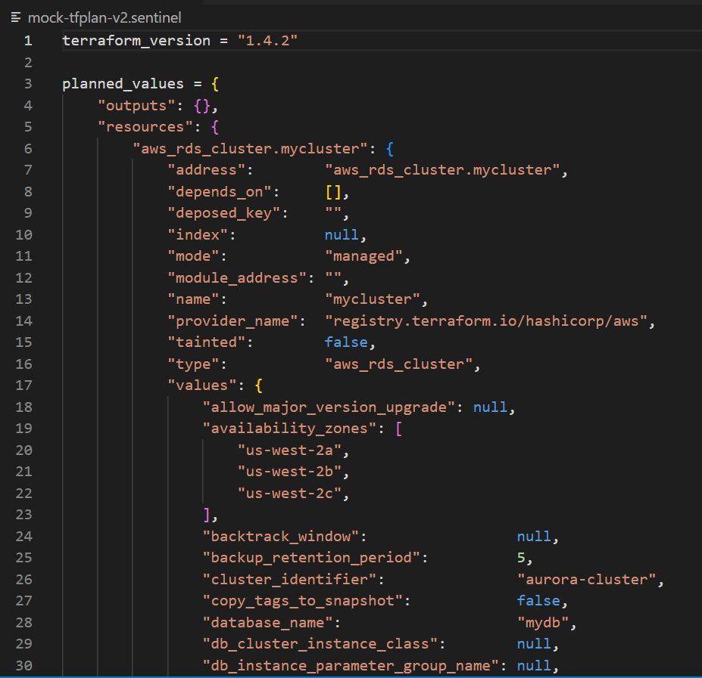
Mock file for tfplan-v2

Slide 29
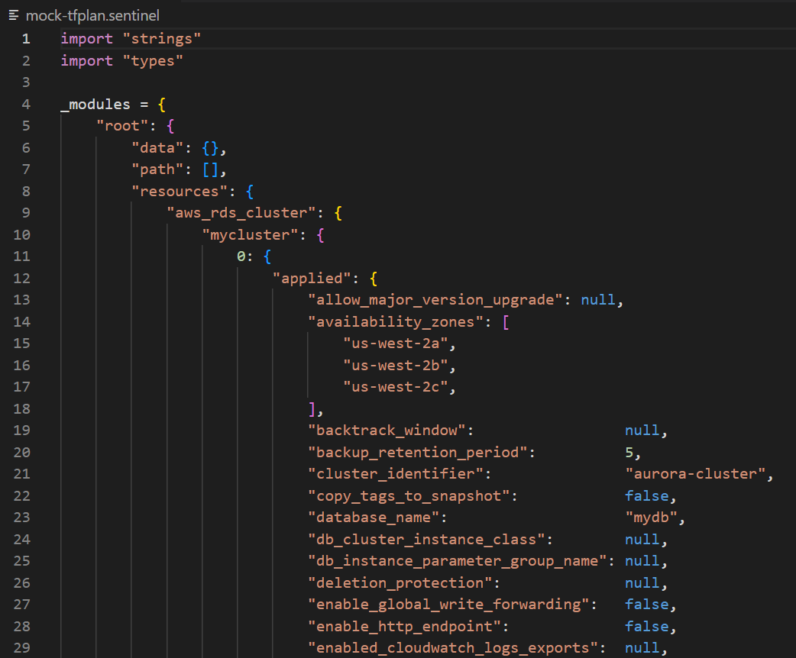
Mock file for tfplan

Slide 30
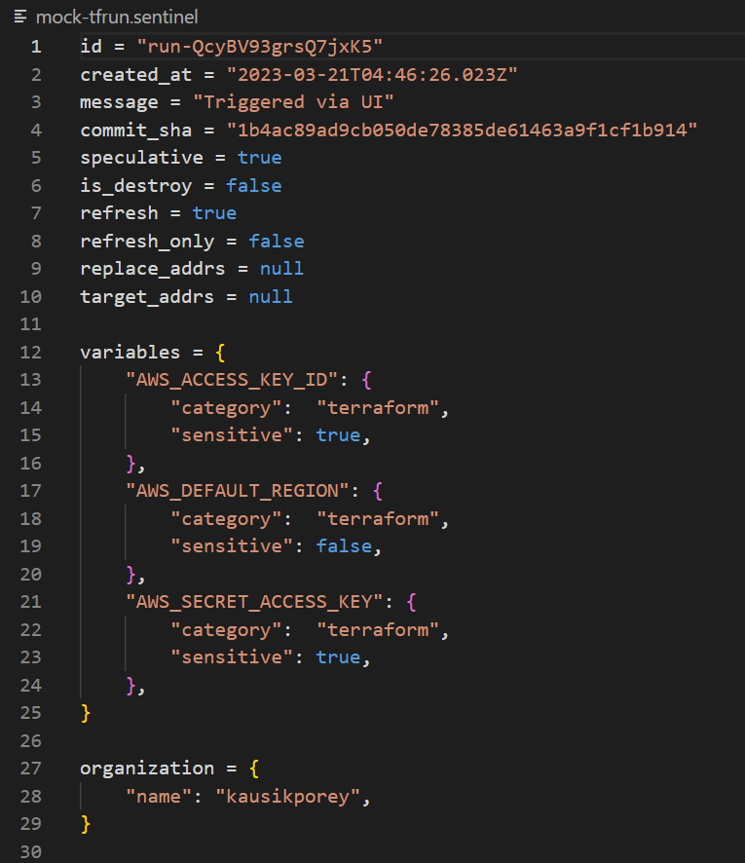
Mock file for tfrun

Slide 31
Creating Sentinel Policy

Slide 32
Set Up the Test Cases Directory for the CLI
To test your policy with the Sentinel CLI, you first need to set up test cases that use the tfplan/v2 mock you generated earlier.
Under the directory containing your policy, create a test directory.
Under the test directory, create a directory with the same name as your policy, but without the ".sentinel" extension.
So, for our restrict-aws-rds-cluster.sentinel policy, we create the restrict-aws-rds-cluster directory under the test directory.

Slide 33
Copy Mocks and Create Test Cases
Copy the mock-tfplan-v2.sentinel mock file that you downloaded and extracted from your workspace.
Paste it inside the test/ restrict-aws-rds-cluster folder
Change the name of the mock file to mock-tfplan-pass.sentinel.
Create a second copy of the file called mock-tfplan-fail.sentinel.
Create pass.hcl and fail.hcl files that have the text on the next two slides respectively.

Slide 34
Common Functions
The Instruqt track in this workshop embeds two Sentinel modules with many common functions that can be used in policies.
These are copies of the functions located here.
The policy we just examined called the following functions:
find_resources(type)
filter_attribute_not_in_list(resources, attr, allowed, prtmsg)
There are other find and filter functions in the above modules.
The filter functions print all violations if prtmsg is true.
Additionally, the filter functions call a very useful function:
evaluate_attribute(r, attribute)

Slide 35
Folder Structure
Documents
aws rds cluster
common functions
tfplan-functions
tfplan-functions.sentinel
test
restrict-aws-rds-cluster
fail.hcl
pass.hcl
mock-tfplan-fail.sentinel
mock-tfplan-pass.sentinel
main.tf
restrict-aws-rds-cluster.sentinel

Slide 36
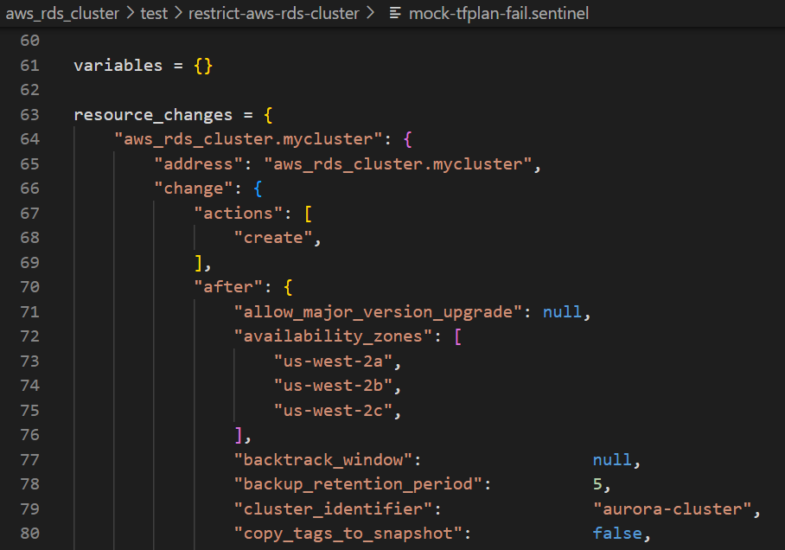
Mock File for Pass Test Case

Slide 37
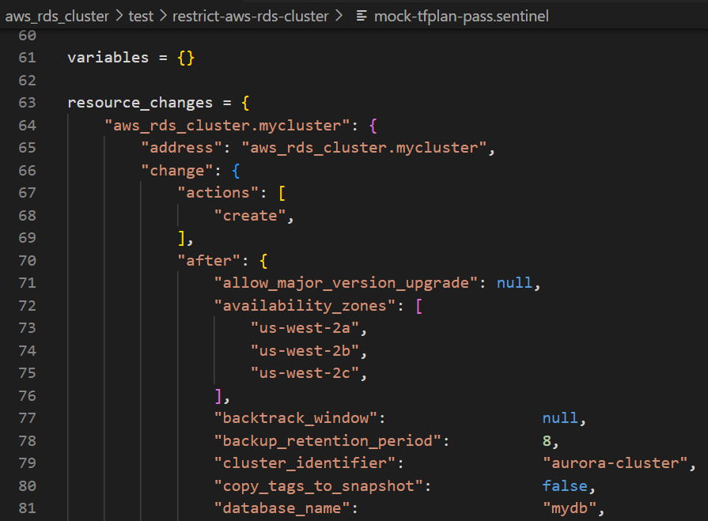
Mock file for Fail Test Case

Slide 38
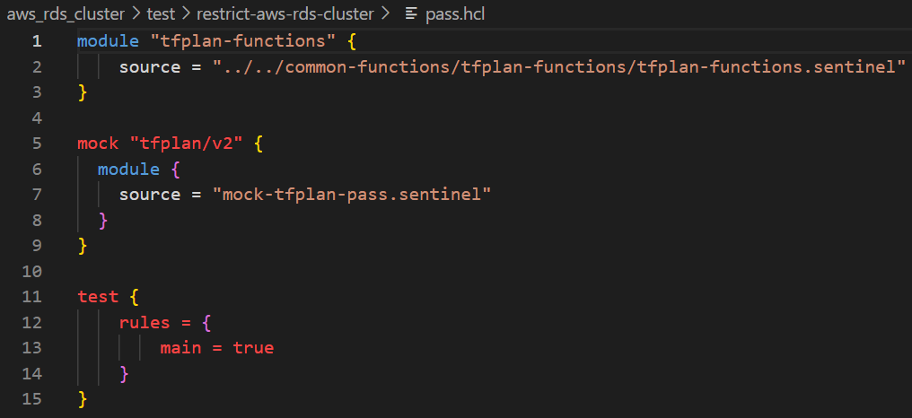
Pass.hcl

Slide 39
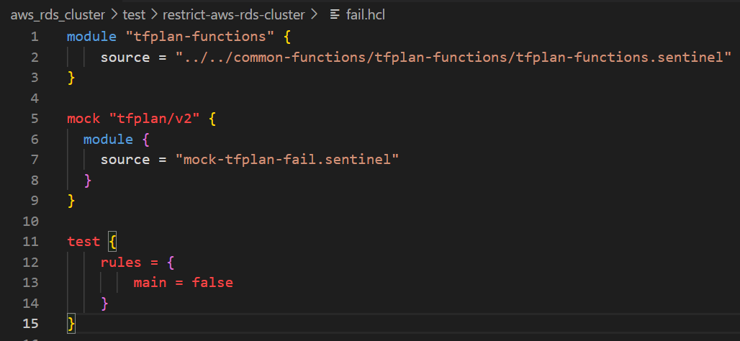
Fail.hcl

Slide 40
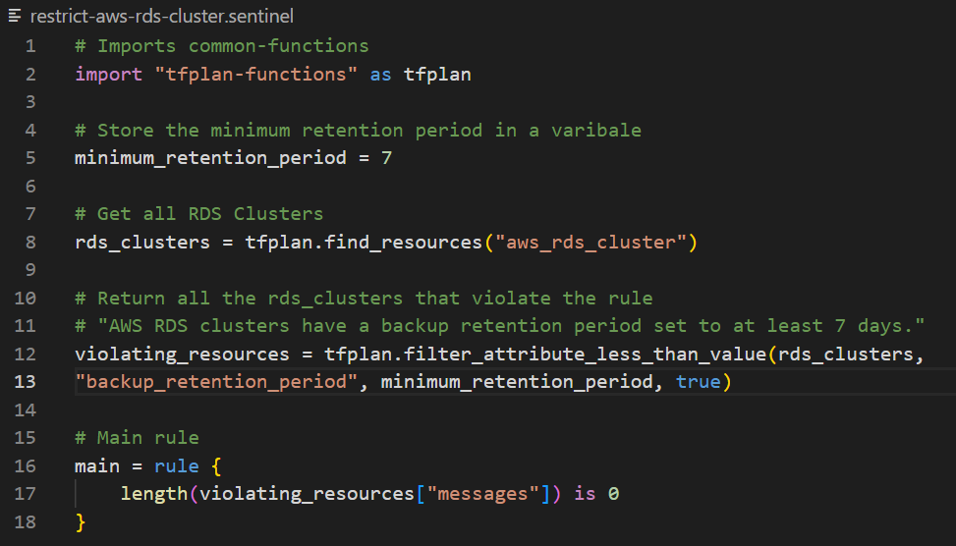
Sentinel Policy

Slide 41
Testing Sentinel Policy

Slide 42
Test Your Policy with the CLI
Now that you have set up your test cases, you can test your policy with the Sentinel CLI.
Navigate back to the directory containing your policy.
Run the following command:
sentinel test restrict-aws-rds-cluster.sentinel
To see the outputs of the print statements, change this to:
sentinel test –verbose restrict-aws-rds-cluster.sentinel
You can also apply a policy with the sentinel apply command, but you must set up a Sentinel configuration file like the "sentinel.json" file downloaded with the mocks or a "sentinel.hcl" file.

Slide 43
Test Your Policy with the CLI
The first command gives:
PASS - restrict-aws-rds-cluster.sentinel
PASS - test\restrict-aws-rds-cluster\fail.hcl
PASS - test\restrict-aws-rds-cluster\pass.hcl
1 tests completed in 65.1921ms

Slide 44


Slide 45
EY | Building a better working world
EY exists to build a better working world, helping create long-term value for clients, people and society and build trust in the capital markets.
Enabled by data and technology, diverse EY teams in over 150 countries provide trust through assurance and help clients grow, transform and operate.
Working across assurance, consulting, law, strategy, tax and transactions, EY teams ask better questions to find new answers for the complex issues facing our world today.
EY refers to the global organization, and may refer to one or more, of the member firms of Ernst & Young Global Limited, each of which is a separate legal entity. Ernst & Young Global Limited, a UK company limited by guarantee, does not provide services to clients. Information about how EY collects and uses personal data and a description of the rights individuals have under data protection legislation are available via ey.com/privacy. EY member firms do not practice law where prohibited by local laws. For more information about our organization, please visit ey.com.
Ernst & Young LLP is a client-serving member firm of Ernst & Young Global Limited operating in the US.
© 2022 Ernst & Young LLP. All Rights Reserved.
2022-3988662 ED None
This material has been prepared for general informational purposes only and is not intended to be relied upon as accounting, tax, legal or other professional advice. Please refer to your advisors for specific advice.
ey.com

